Slide 1
Fullstack School
FRONTEND

Slide 2
Angularjs
Modules
Controllers
Data binding
Dependency injection
$scope
routing
$compile
$digest vs $apply
$filters
$broadcast vs $emit
services
factory
provider
$http
directives
components

Slide 3
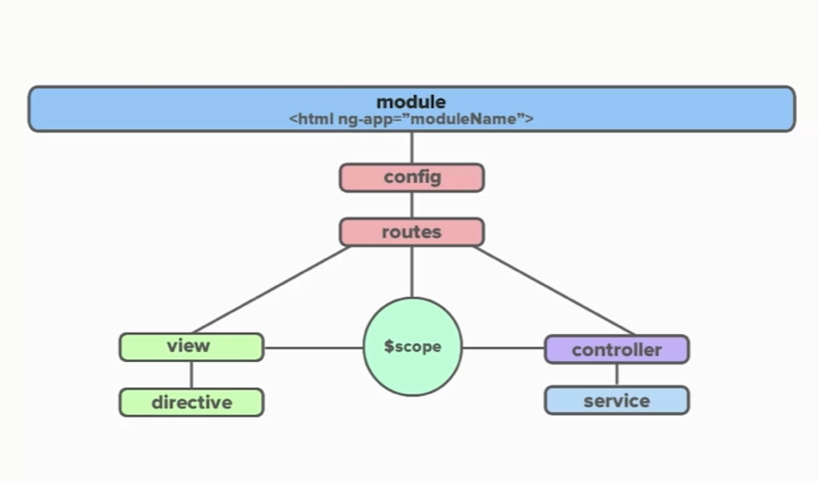
Angularjs big picture

Slide 4
Angularjs Modules
A module is the main way to define an AngularJS app.
Advantages of use modules:
Keeps our global namespace clean
Eases writing tests as well as keeps them clean as easy to target isolated functionality
Eases to share code between applications
Allows different parts of the code to be loaded in any order

Slide 5
Angularjs Controllers
The controller in AngularJS is a function that adds additional functionality to the scope of the view. They are used to set up an initial state and to add custom behavior to the scope object.

Slide 6
Angularjs Data-Binding
Is the automatic synchronization of data between the model and view components. The way that Angular implements data-binding lets you treat the model as the single-source-of-truth in your application.
The compilation step produces a live view. Any changes to the view are immediately reflected in the model, and any changes in the model are propagated to the view.
Because the view is just a projection of the model, the controller is completely separated from the view and unaware of it.

Slide 7
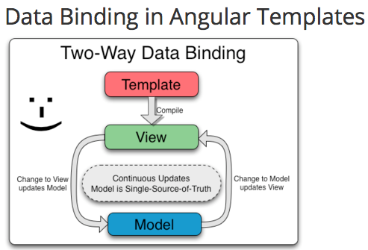
Angularjs Data-Binding

Slide 8
Angularjs Dependecy Injection
Dependency Injection (DI) is a software design pattern that deals with how components get hold of their dependencies.
The AngularJS injector subsystem is in charge of creating components, resolving their dependencies, and providing them to other components as requested.

Slide 9
Angularjs $scope
The $scope object is where we define the business-logic of the application, the methods in our controllers and reference properties in the views.
Scopes provide the ability to watch for model changes.
This $rootScope is the eventual parent of all $scope objects.
This $scope object is the data model in Angular.
You can think of scopes as view models.

Slide 10
Angularjs routing
AngularJS supports SPA using routing module ngRoute. This routing module acts based on the url. When a user requests a specific url, the routing engine captures that url and renders the view based on the defined routing rules.

Slide 11
Angularjs $compile
The $compile service is the service to use for compilation. Invoking $compile against markup will produce a function you can use to bind the markup against a particular scope (what Angular calls a linking function). After linking, you’ll have DOM elements you can place into the browser.

Slide 12
Angularjs $digest vs $apply
$apply() and $digest() have some similarities and differences. They are similar in that they both check what's changed and update the UI and fire any watchers.
One difference between the two is how they are called. $digest() gets called without any arguments. $apply() takes a function that it will execute before doing any updates.
The other difference is what they affect. $digest() will update the current scope and any child scopes. $apply() will update every scope. So most of the time $digest() will be what you want and more efficient.

Slide 13
Angularjs $filters
A filter provides a way to format data to display to the user.

Slide 14
Angularjs $broadcast vs $emit
$broadcast() as well as $emit() allow you to raise an event in your AngularJS application.
The difference between $broadcast() and $emit() is that the former sends the event from the current controller to all of its child controllers. That means $broadcast() sends an even downwards from parent to child controllers. The $emit() method, on the other hand, does exactly opposite. It sends an event upwards from the current controller to all of its parent controllers.

Slide 15
Angularjs Services
AngularJS services are substitutable objects that are wired together using dependency injection (DI). You can use services to organize and share code across your app.
AngularJS services are:
Lazily instantiated – AngularJS only instantiates a service when an application component depends on it.
Singletons – Each component dependent on a service gets a reference to the single instance generated by the service factory.

Slide 16
Angularjs Factory
As we’ve seen the factory() method is a shorthand for creating and configuring a service.

Slide 17
Angularjs Provider
A provider is the most sophisticated method of all the providers. It allows you to have a complex creation function and configuration options. A provider is actually a configurable factory.

Slide 18
Angularjs Components
In AngularJS, a Component is a special kind of directive that uses a simpler configuration which is suitable for a component-based application structure.
This makes it easier to write an app in a way that's similar to using Web Components or using the new Angular's style of application architecture.
Advantages of Components:
simpler configuration than plain directives
promote sane defaults and best practices
optimized for component-based architecture
writing component directives will make it easier to upgrade to Angular

Slide 19
Thank you

